Slide 1
Central versus Decentral
Wastewater Treatment plants
BouwCoach Engineering BV

Slide 2
Traditional, Central Systems
Everytime new design and 3-4 years building time
Expensive piping and pumping to wwtp
Expensive piping and pumping between towns
Functions only when 80% is connected
Sewage to traditional wwtp
Canalisation between villages
BouwCoach Engineering BV

Slide 3
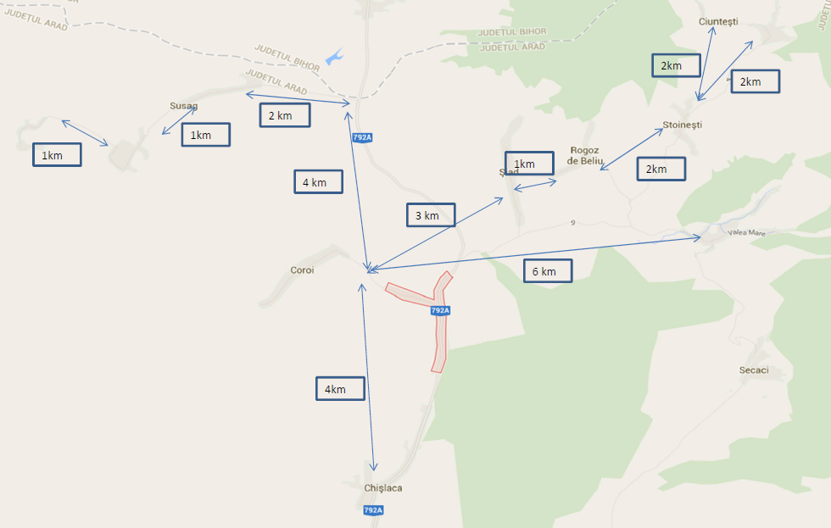
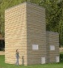
Innovative, Decentral Systems in Rural Areas
Realisation in Phases!
X
10km
This Example $3,053,680 Cheaper!
Sewage to traditional wwtp
BouwCoach Engineering BV

Slide 4
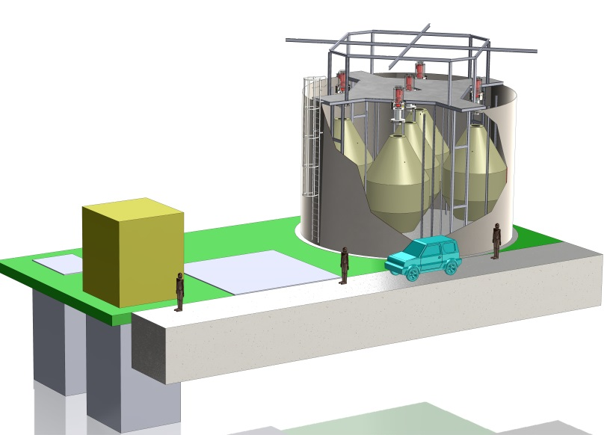
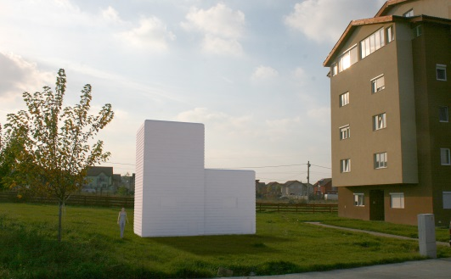
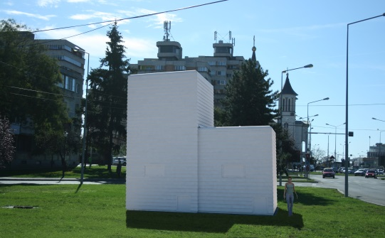
Innovative, Decentral Systems
Plug and Play, when canalisation phase is ready
Closed systems: no smell
Only town sewerage
Modular design: 3 months building time
50-100-175-350-700-1050-1400 systems
Modular design, 4 weeks building time
1.750-50.000 systems
Investment: 62% cheaper
Everytime new design and 3-4 years building time
Functions only when 80% is connected
Expensive piping and pumping to wwtp
Expensive piping and pumping between towns
BouwCoach Engineering BV

Slide 5
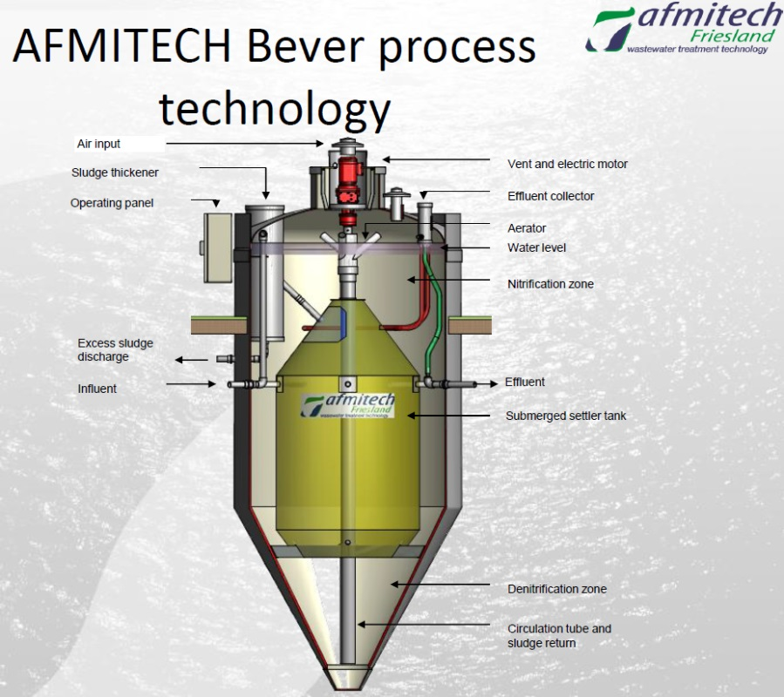
DCD Mini Modular Wasterwaterplant
BouwCoach Engineering BV

Slide 6
DCD Mini Modular Wasterwaterplant
Purifying System
For purifying the wastewater, the DCD-Bever works with the activated sludge process which is
used worldwide (patented technology Afmitech Friesland bv). In this process the pollution is degraded biologically by micro organisms floating in the water. These micro organisms form a floc, which is the so-called activated sludge.
Because this activated sludge is heavier than the water in the tank, it will sink down in the
settling compartment from where it can be separated from the water flow.
The installation is made vertically with a surface aerator which creates a vertical circulation by
intermittent aeration. This vertical circulation makes denitrification possible.
The system itself signalizes the amount of wastewater coming in and automatically adjusts the
oxygen input while the purification process continues; this means that the DCD-Bever has a
continuous purification process with a discontinuous control. In this way, the wastewater
treatment system can perform properly with changing seasonable loads.
The excess growth of sludge is automatically thickened and periodically drained to the excess
sludge sump. In this way the system keeps the concentration of excess sludge in the aeration
compartment stable and prevents the wastewater treatment tank from becoming overgrown with
sludge.
BouwCoach Engineering BV

Slide 7
Test Results:
Our Bever wastewater treatment system (patented technology Afmitech Friesland bv) is extensively tested for 26 weeks in 2002 by the Van Hall Larenstein Institute, Leeuwarden. During the attestation, only flux-proportional collect samples of the effluent were taken and analyzed by an accredited research laboratory.
The requirements at the effluent of an IBA-class IIIA were:
Parameters | Concentrations in any 24-hour aggregate sample (mg/l) | Concentrations in any stitch sample (mg/l)
BOD₅ | < 20 | < 40
COD | < 100 | < 200
N-total | < 30 | < 60
NH₄+ | < 2 | < 4
SS | < 30 | < 60
BouwCoach Engineering BV

Slide 8
Influent parameters for testing
Parameters | Average Value | Maximal Value | Minimal Value
BZV₅ | 308,8 | 380,0 | 259,8
CZV | 783,3 | 1028,3 | 669,3
N-totaal | 68,8 | 79,1 | 54,8
SS | 390,9 | 615,0 | 307,5
CZV : BZV | 2,6 | 3,0 | 2,0
Test results Effluent
Parameters | Average Value | Maximal Value | Minimal Value
BZV₅ | < 3,0 | < 3,0 | < 3,0
CZV | 40 | 50 | 30
N-totaal | 10,0 | 26,8 | 2,2
NH₄+ | 0,9 | 1,9 | < 0,2
SS | 2,7 | 7,7 | < 2,0
BouwCoach Engineering BV

Slide 9
Cost Comparisation
For 25 communities (within Europe) businesscases are established.
These communities vary from 700 inhabitants spreaded over 3 towns to 3000 inhabitants in 10 villages . The calculated average cost of ownership for complete DCD-Bever community systems (excluded village-canalisation) go down to $ 25,- per inhabitant per year (80% governmental funding included).
When the investment costs are compared, the absence of inter-village sewers and main sewer to a traditional plant, cause a significant cost-difference in favour of decentralized units.
To be able to compare the investment costs with a traditional (50.000-100.000ie) wastewater treatment plant, some assumptions are made:
1) investment costs for traditional plant are $ 220,- per i.e.
2) investment in meter sewage pipe is $ 110,-
3) the distance from “lowest” village to a traditional wwtp is 10km.
These assumptions are based on conservative Key-Figures, nevertheless always discussable.
But the results of the comparisation of average investment costs for DCD-Bever systems and traditional shows a factor 3 in lower costs for decentral systems!
BouwCoach Engineering BV

Slide 10
Modular Approach
The Bever-DCD system is a modular system of decentral wastewater-treatment for communities from 50i.e., 100i.e. and 175i.e in steps up to 2500/5000 i.e.
This modularity guarantees flexibility in phasing, providing any needed growth of connected population and/or availability of canalization.
Also innovation in purification technologies develops fast. This modular approach guarantees, (in combination with 15 or 25 years administrative life-time) the flexibility of replacing systems or system-parts at any time.
Waste and wastewater become more and more a source of energy and raw materials (as for example phosphorus). Modular units can be added for extraction of specific substances and exploiting the energy sources in near future.
At last but not least, the awareness of health-threatening pollutions, as for example medicine and metals, will demand purification on these substances in near future. Our modular systems can be expanded at any time with the newest technology.
BouwCoach Engineering BV

Slide 11
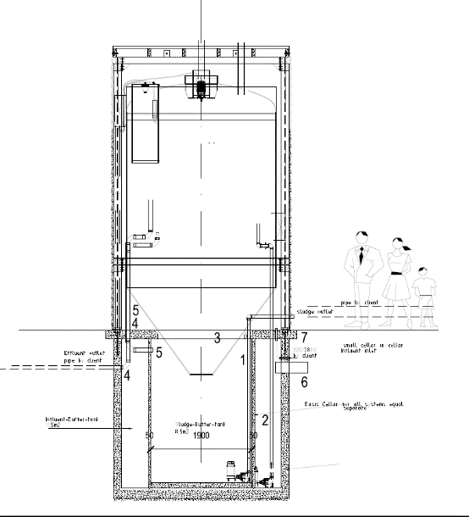
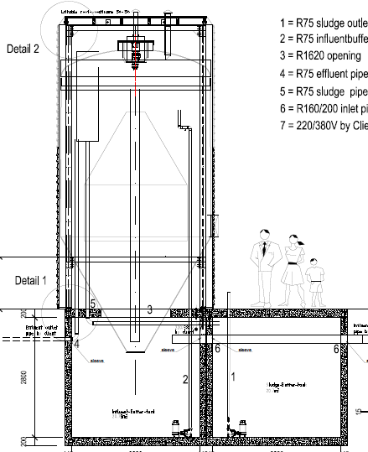
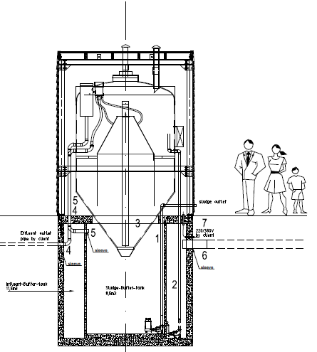
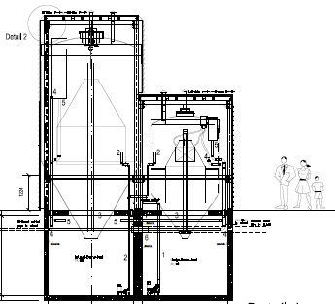
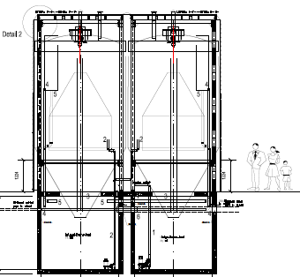
mww0250 i.e.
mww03 100 i.e.
mww04 175 i.e.
mww05 225 i.e.
Mww06 350 i.e.
BouwCoach Engineering BV

Slide 12
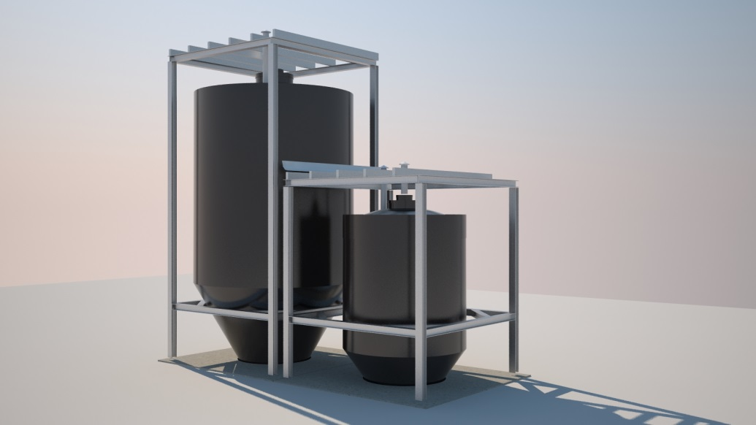
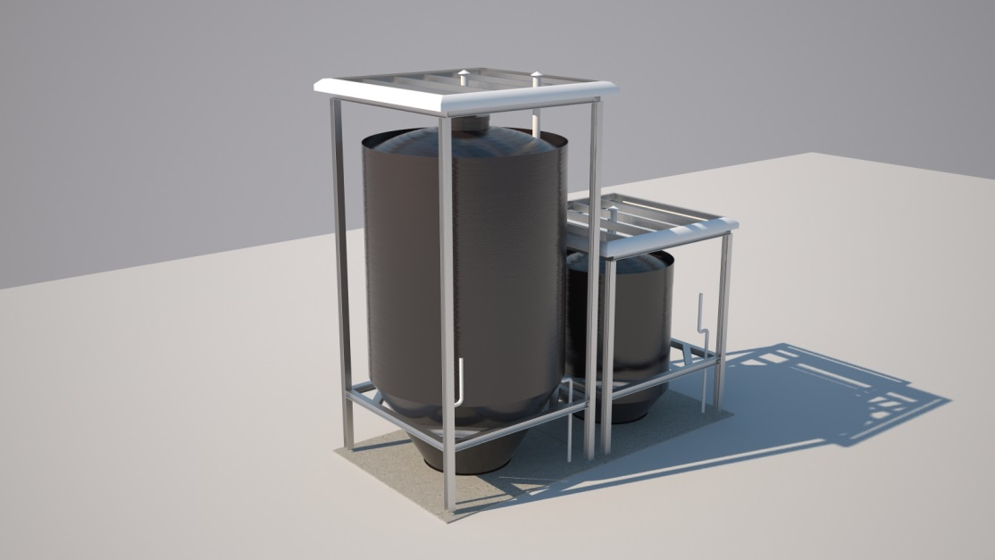
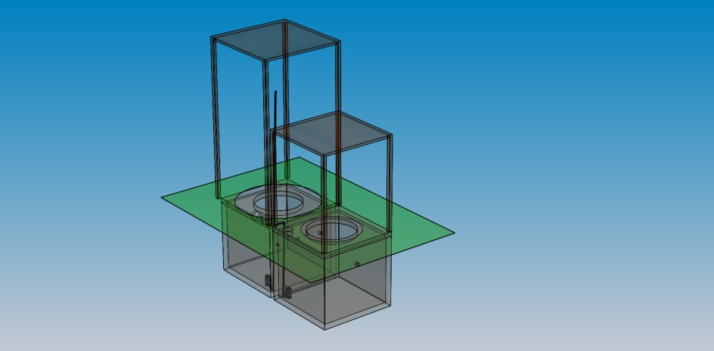
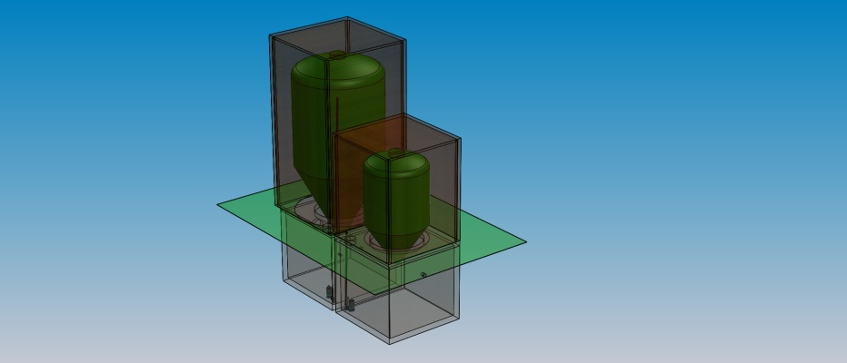
BouwCoach Engineering BV

Slide 13
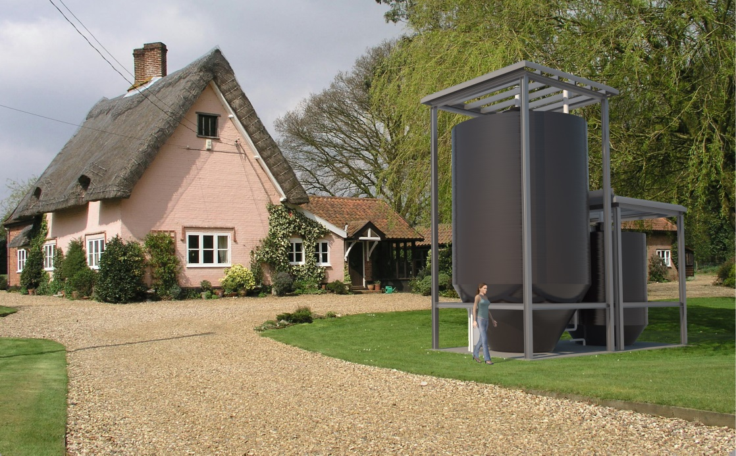
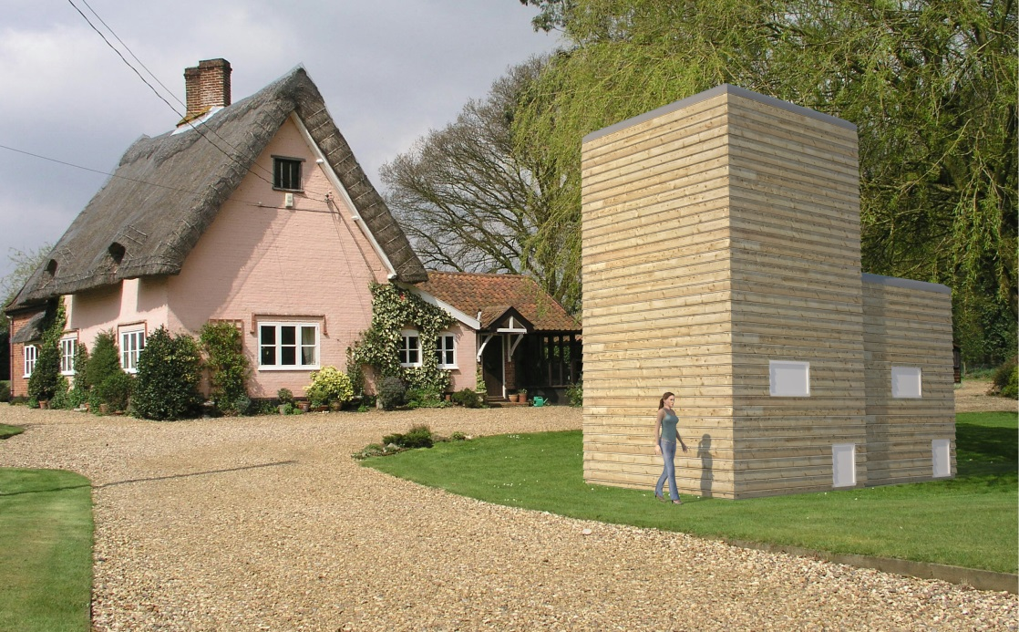
BouwCoach Engineering BV

Slide 14
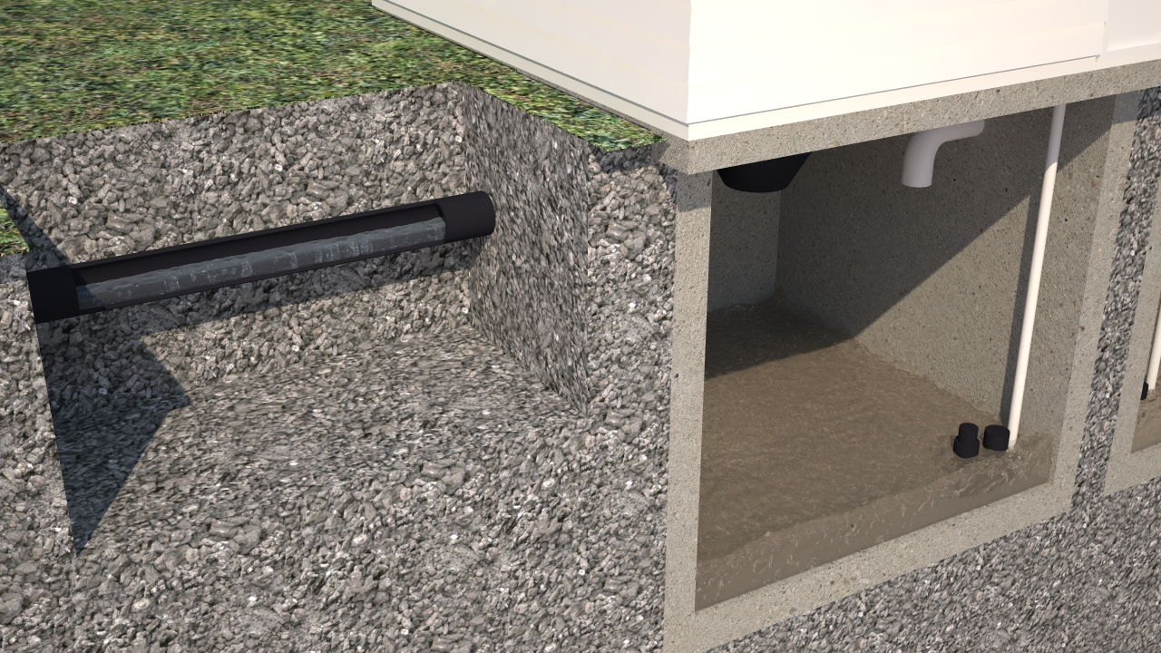
50 to 1400 i.e. modular
Cellars
BouwCoach Engineering BV

Slide 15

1.750-2.500-5.000-10.000……50.000. i.e.
Plug&Play Units
Main process-tank
Sludge Buffer tanks
Pit with automatic bar-screen
Pump-Pit with Service&Control cabin
Influent-Buffering + road
BouwCoach Engineering BV

Slide 16
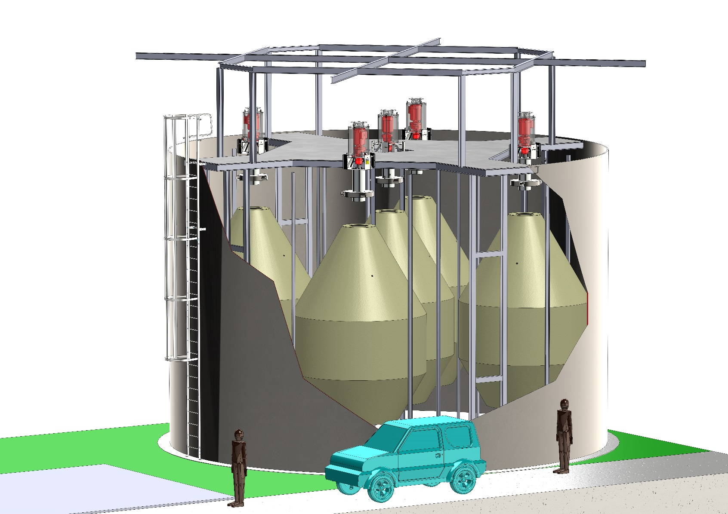
BouwCoach Engineering BV

Slide 17
BouwCoach Engineering BV

Slide 18
BouwCoach Engineering BV

Slide 19
BouwCoach Engineering BV

Slide 20
Contact us and we will make a free businesscase for Your Situation!
Paul de Lange MSc
0031 654 22 3534
bouwcoachconsult@gmail.com
BouwCoach Engineering BV
The Netherlands

